Slide 1
CG2271 Real Time Operating Systems
Lab Lecture 6
Analog – Digital programming
(Reference Guide Chapter 23)

Slide 2
Introduction
Lab Lecture 6 – Analog – Digital Programming

Slide 3
Introduction
In Lab Lecture 5 we saw how to generate “analog” output using the Timer/PWM Modules (TPMs).
In this lecture we will look at the Analog-Digital Converter (ADC) on the MCXC444.
  We will read the visible light sensor on the FRDM-MCXC444 board and use this to control the brightness of the RGB LED.
  Please see Lab Lectures 4 and 5 on how to configure the TPMs to generate PWM to control the LEDs.

Slide 4
ADC Features on the MCXC444
Successive Approximation.
Up to 24 channels, with up to 16 bits of resolution per channel.
  Analog inputs 0 to 3 can operate in “differential mode”.
    Measures voltages relative between two pins, rather than relative to ground.
    Provides more accurate measurements
    Using differential mode reduces the total number of ADC channels available.
  Other inputs operate in single ended mode.

Slide 5
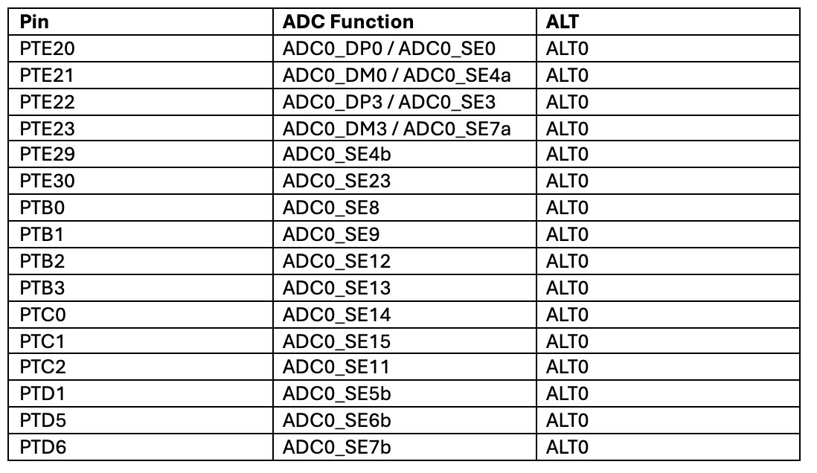
ADC Features on the MCXC444
The ADC input pins are spread around the MCXC444 chip – Note that not all 24 inputs are available (e.g. ADC0_SE10 does not exist)

Slide 6
ADC Features on the MCXC444
Note the existence of “a” and “b” versions of some pins, e.g. ADC0_SE7a and ADC0_SE7b.
  “b” pins are controlled using the ADC0_SC1b status and control register (see later), while all other pins are controlled using ADC0_SC1a.
  ADC conversion on the “b” pins can only be triggered by internal hardware.
    I.e. We cannot start conversion on the “b” pins through programming.
    Conversion on the ”a” and other pins can be triggered by both internal hardware and software.

Slide 7
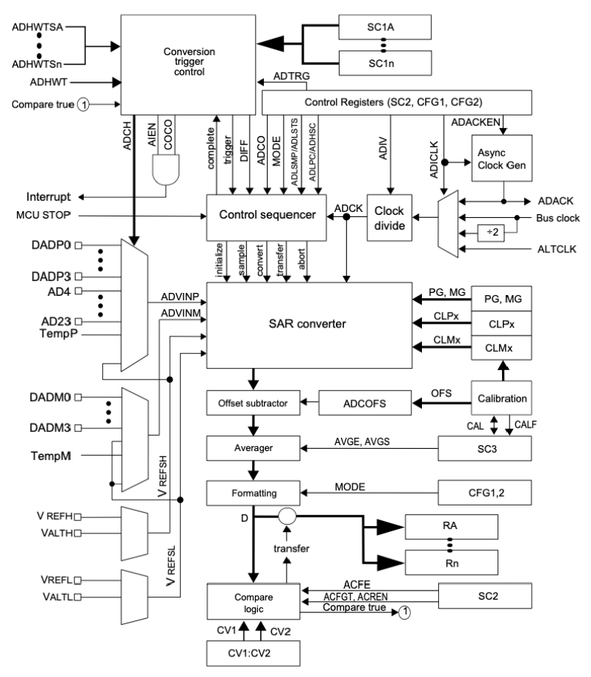
ADC Features on the MCXC444

Slide 8
Configuring the ADC Module
The FRDM-MCXC444 board has a light sensor connected to ADC0_SE3 on PTE22.
  Our examples will assume we are using this pin.

Slide 9

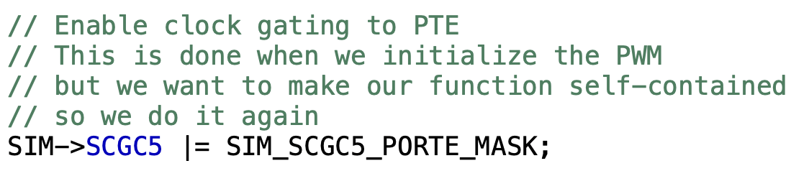
ADC Clock Gating
Clock gating is controlled by SIM_SCGC6; we need to turn this on:
We are accessing PTE22, so we turn on the clock to PORTE on SIM_SCGC5

Slide 10
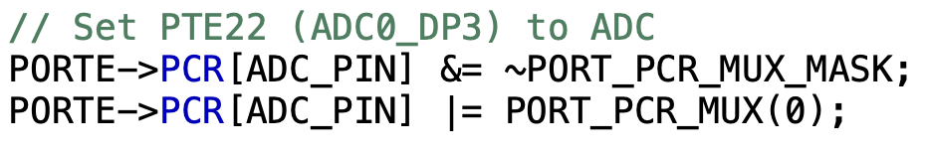
ADC Pin Configuration
Select the correct ALT value (ALT0) for the ADC pin you want to use (PTE22 in our example)

Slide 11
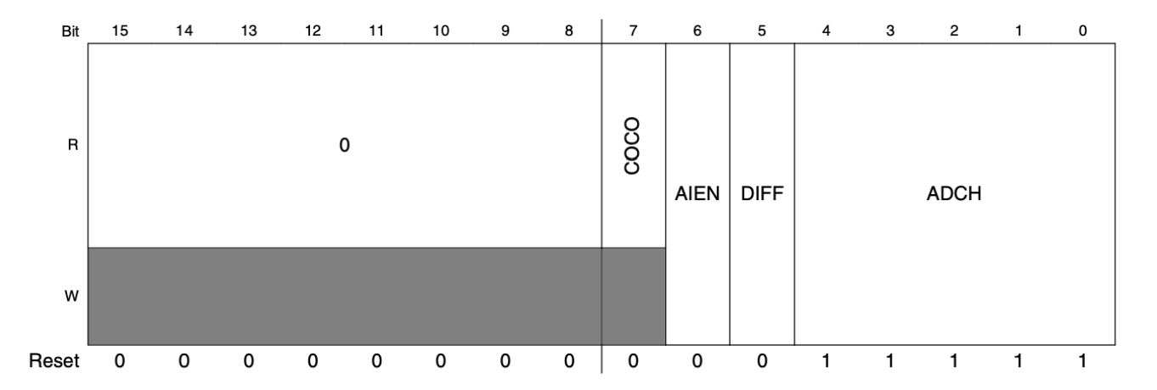
ADC0_SC1a
We now need to configure the ADC first. We begin with Status and Control Register 1.
  ADC0_SE3 is not a “b” pin, so we will configure ADC0_SC1a. In CMSIS it is accessible via: ADC0->SC1[0].

Slide 12
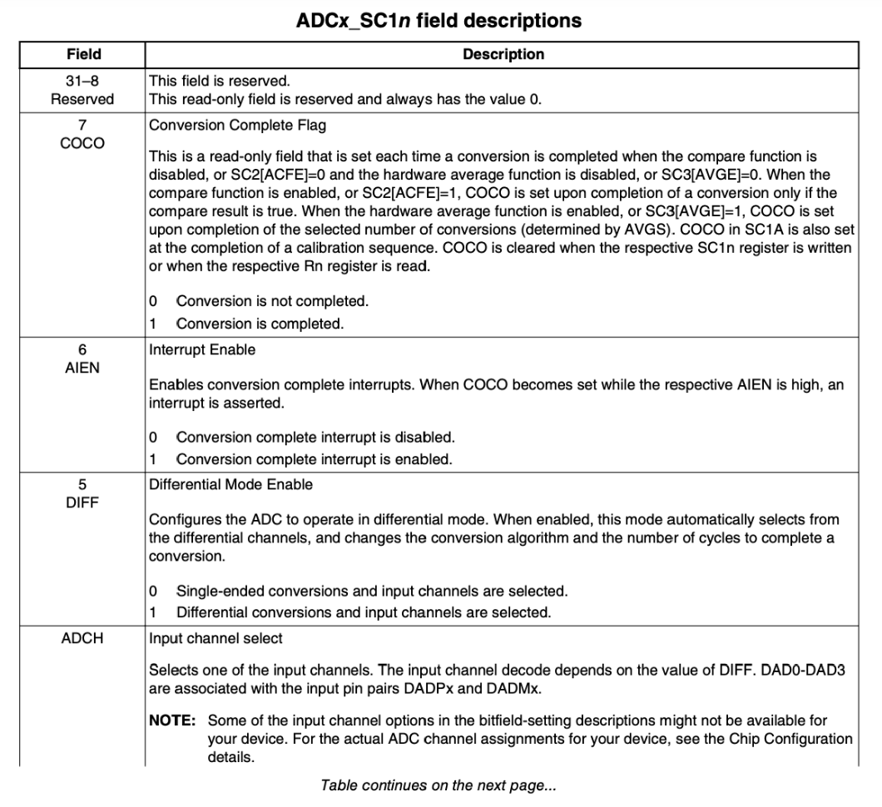
ADC0_SC1a

Slide 13
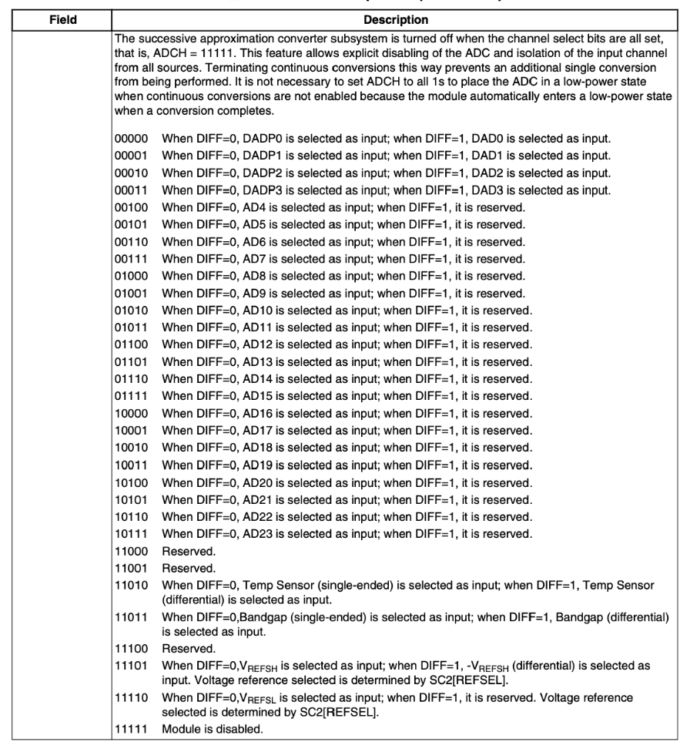
ADC0_SC1a

Slide 14
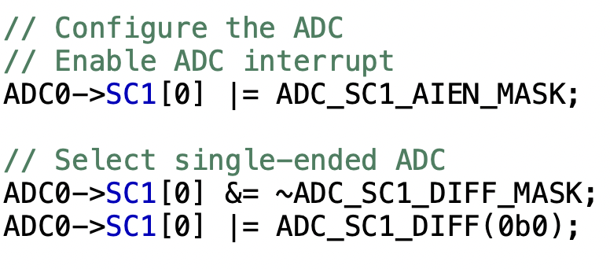
ADC0_SC1a
We will choose the ADC channel later; for now, we want to enable interrupts, and disable differential mode by setting AIEN to 1 and DIFF to 0:

Slide 15
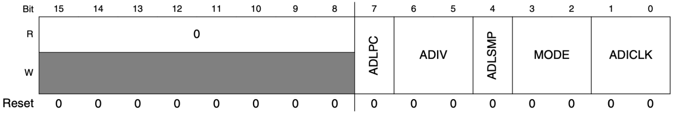
ADC0_CFG1
We will now look at the ADC Configuration Register 1, which lets us choose the resolution, low power/normal power mode, long sample mode, etc.

Slide 16
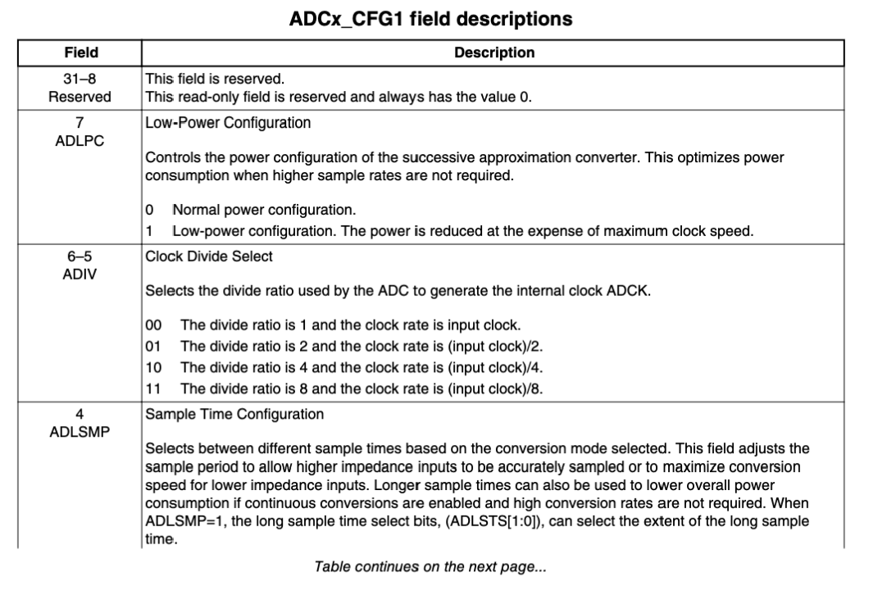
ADC0_CFG1

Slide 17
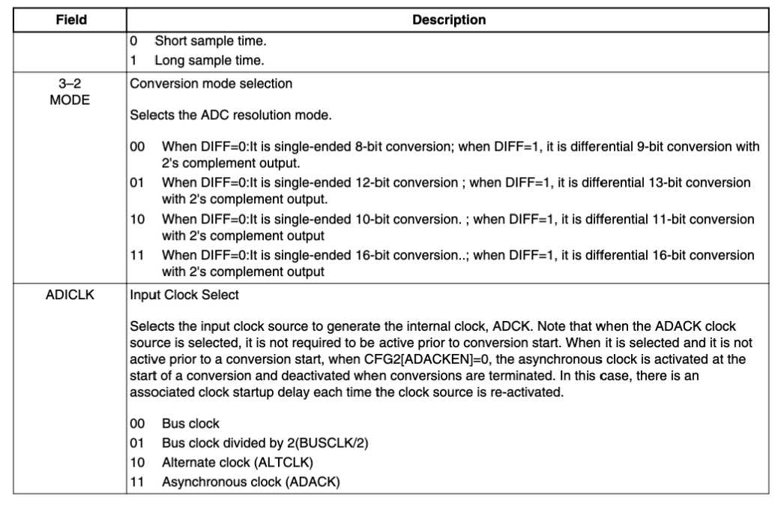
ADC0_CFG1

Slide 18
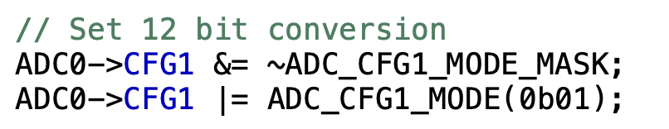
ADC0_CFG1
We will keep everything as default, but use a 12-bit resolution (0b01):

Slide 19
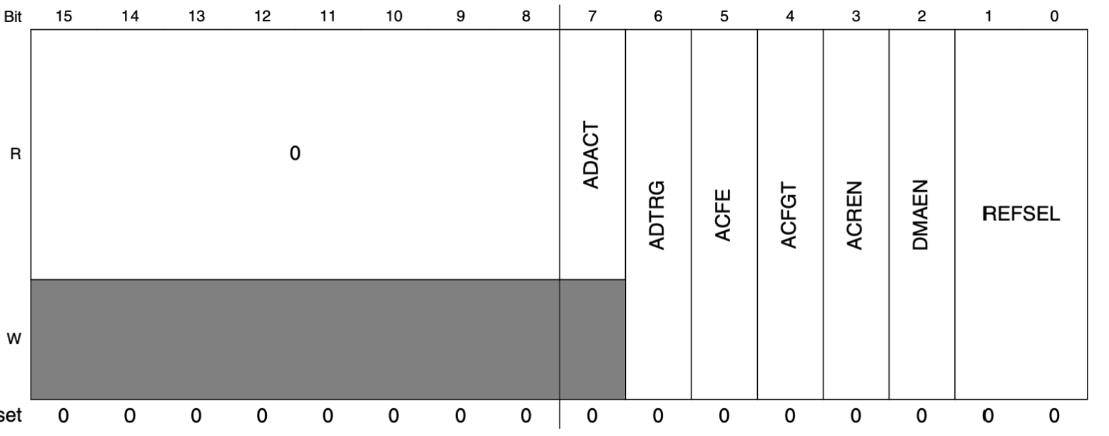
ADC0_SC2
The Status and Control Register (ADC0_SC2) lets us choose whether to trigger the conversion in software or via internal hardware, and choose the reference voltage source, amongst other things.

Slide 20
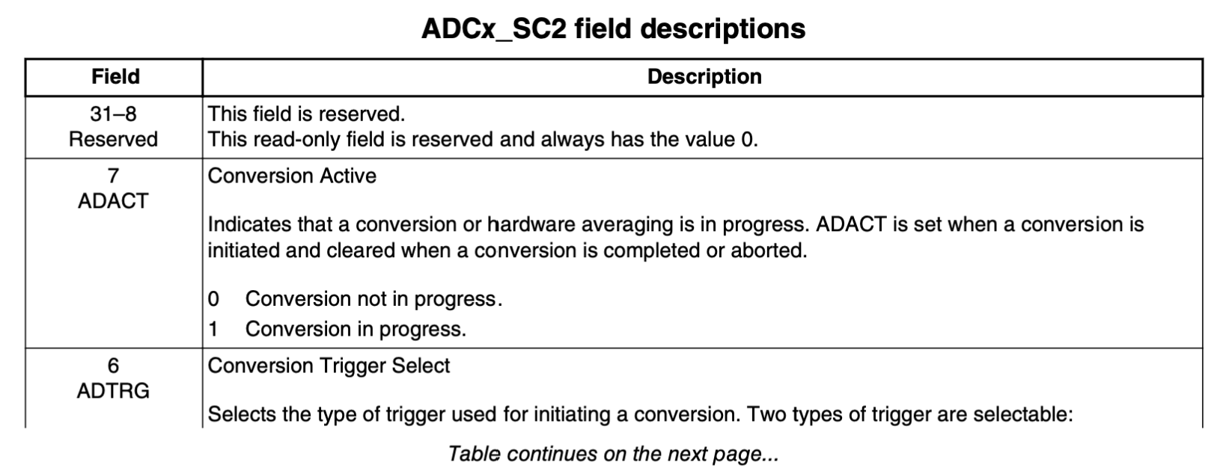
ADC0_SC2

Slide 21
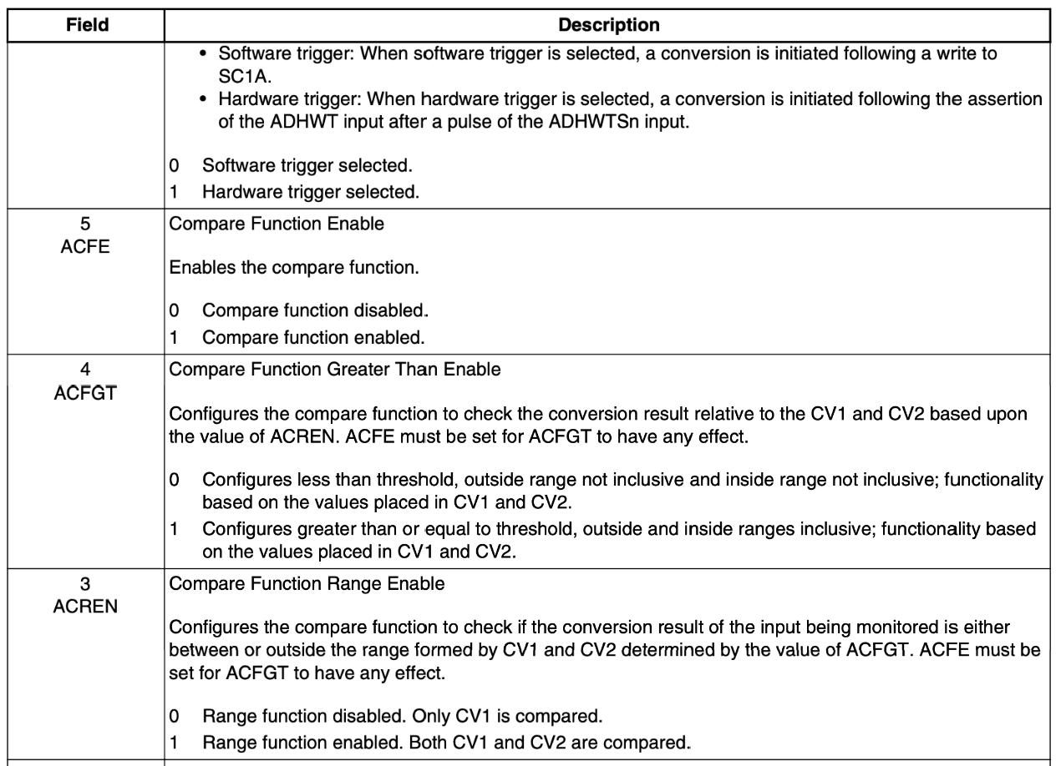
ADC0_SC2

Slide 22
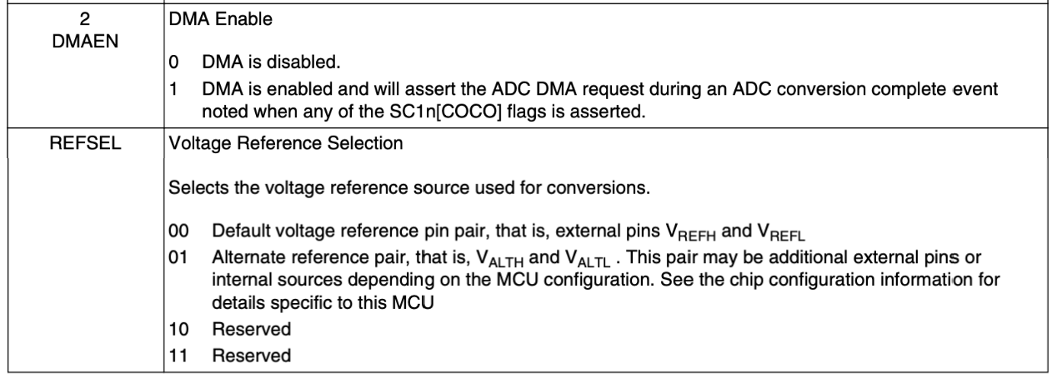
ADC0_SC2

Slide 23
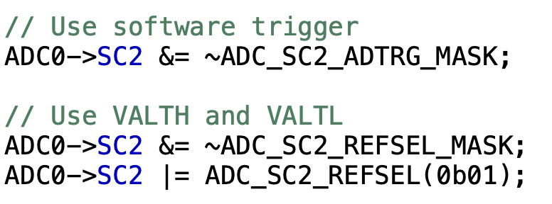
ADC_SC2
We are interested in two fields in ADC0_SC2:
  ADTRG: Select between software or hardware to trigger conversion.
    We want to trigger in software by writing to ADC0_SC1.
  REFSEL: Choose reference voltage.
    The FRDM-MCXC444 board uses the alternate voltage reference VALTH and VALTL rather than the default voltage reference VREFH and VREFL.

Slide 24
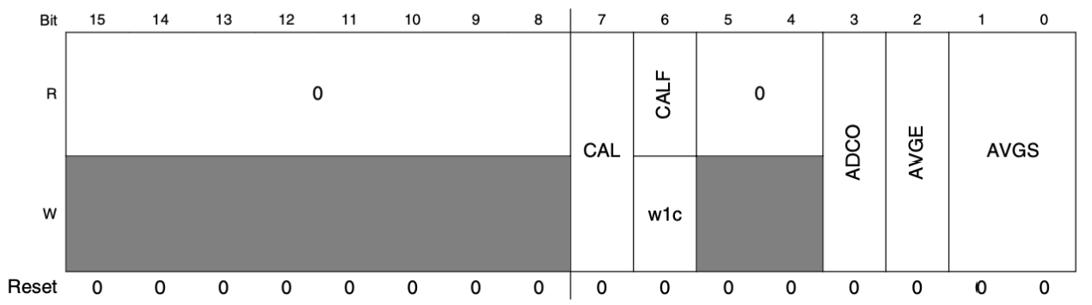
ADC0_SC3
The Status and Control Register 3 (ADC0_SC3) lets us control calibration, averaging and continuous conversion.

Slide 25
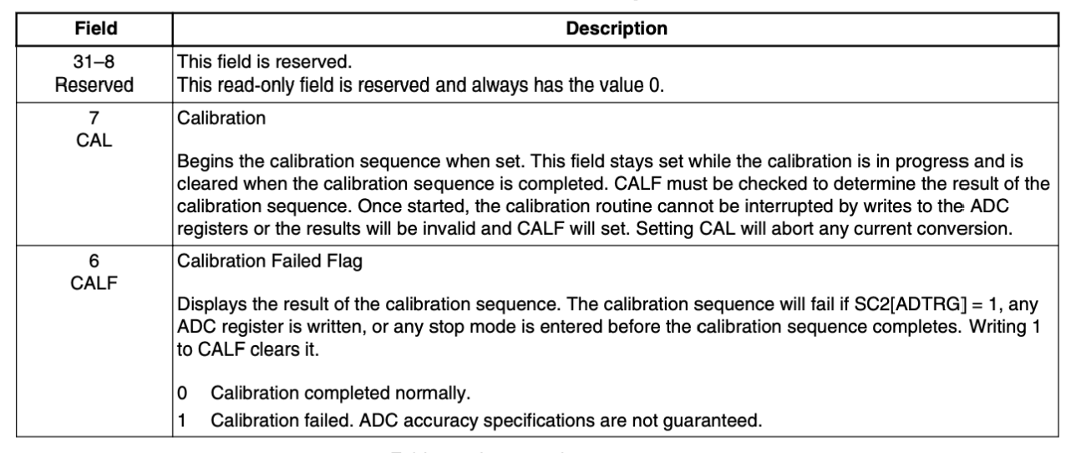
ADC0_SC3

Slide 26
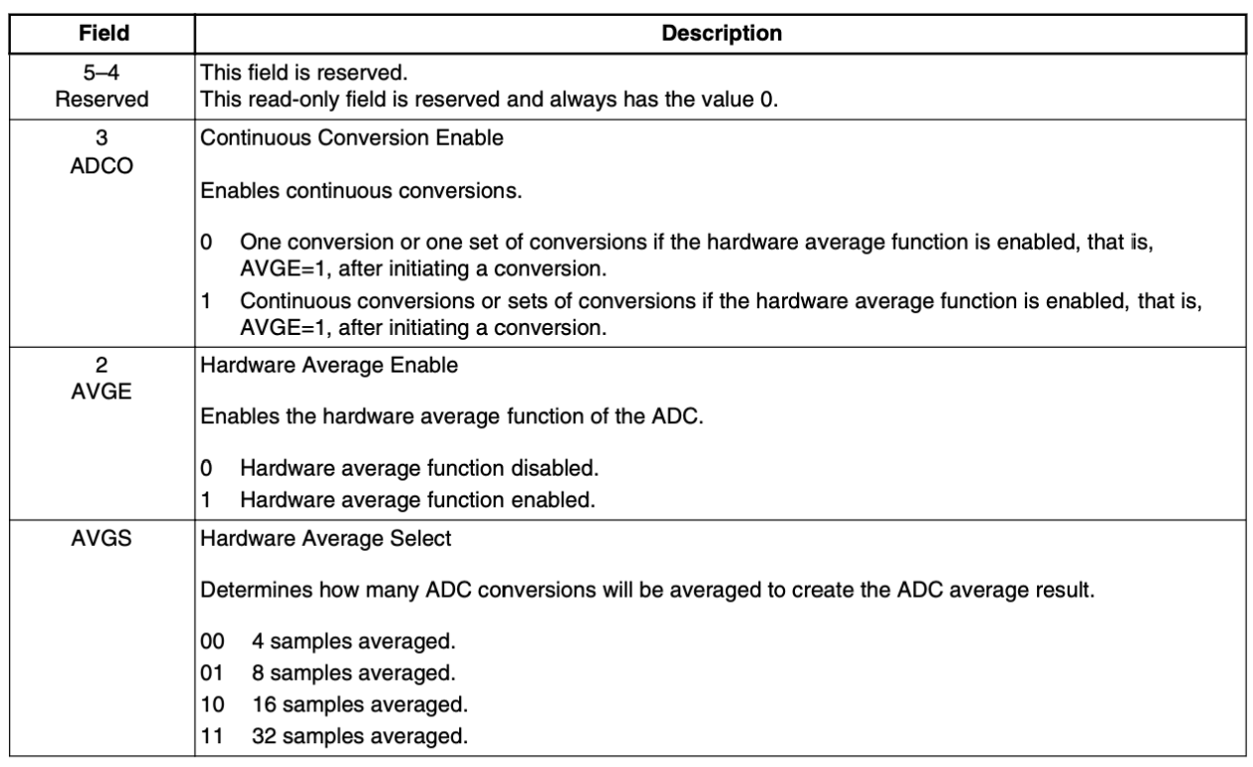
ADC0_SC3

Slide 27
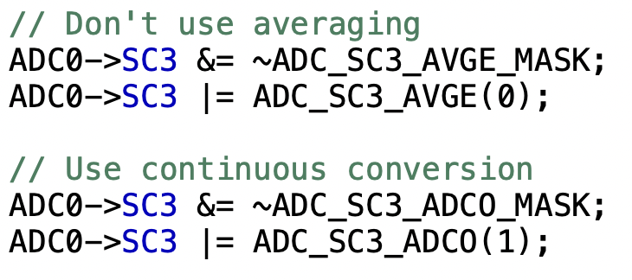
ADC0_SC3
ADC0 can average across 4, 8, 16 or 32 samples to produce its value.
  We aren’t interested in this, so we are going to turn off averaging.
We can do continuous conversion:
  A new conversion begins after the previous ends.

Slide 28
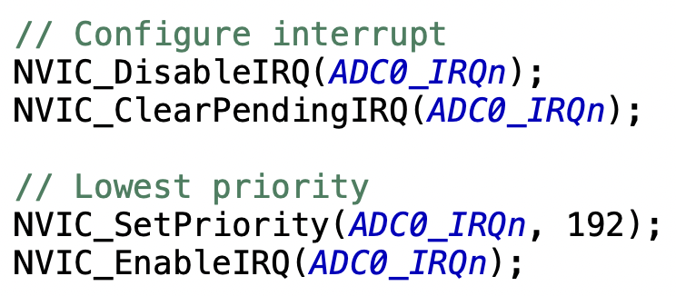
Setting up IRQ
ADC0 triggers the ADC0_IRQn interrupt if AIEN in ADC0_SC1 is set.
  We set the priority number and enable interrupts:

Slide 29

Starting Conversion
The ADCH field in ADC0_SC1 lets us choose which channel to convert:
  Set to 0b11111 to stop conversions
  Set to any other channel to start conversion.

Slide 30
Getting Results
We have configured our ADC to trigger ADC0_IRQn each time conversion is completed.
  Caught by the ADC0_IRQHandler ISR.
Must check the COCO (Conversion Complete) flag in ADC0_SC1a.
  Actual result can be read from ADC0_Ra (ADC0->R[0])

Slide 31
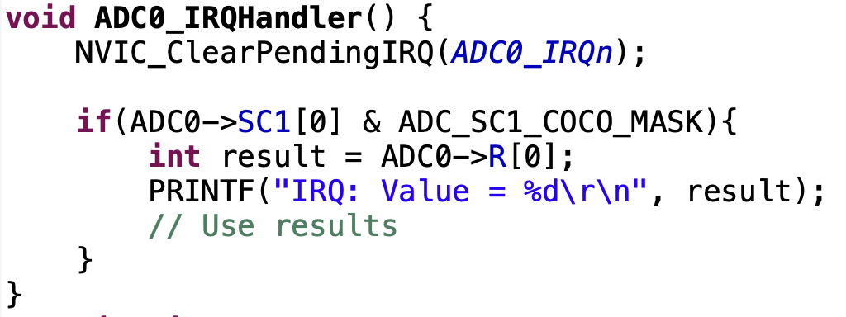
Getting Results

Slide 32
Conclusion
In this chapter we looked at how to program the Analog to Digital Convertor (ADC) on the MCXC444.
In the next chapter we will look at how to do serial communications on the MCXC444.

